Slide 1
Who is this for?
All Clinical Research Facility Staff who will be involved in equalities monitoring.
Aims
By the end of taking this briefing attendees:
Be able to explain the purpose of working with people and patients in research
Be able to explain how health inequalities are and how they manifest in research
Be able to explain what inclusive research is and how it is being carried out at the CRF
Be aware of the UK Public Involvement Standards and how they related to NIHR research

Slide 2



Inclusive Research at Manchester NIHR Clinical Research Facility

Slide 3

Aims for this session
Introduce Vocal and public involvement and engagement.
Understanding inclusive research and our role in the work.
Understand what health inequalities are.
Introduce the planned inclusive research work.
Notes:
We work the NIHR Public Involvement Standards. The standards are a framework that allow organizations like the CRF to understand what good public involvement in research looks like and how we can work to support studies to deliver that.
So what does public involvement look like at our sites?

Slide 4

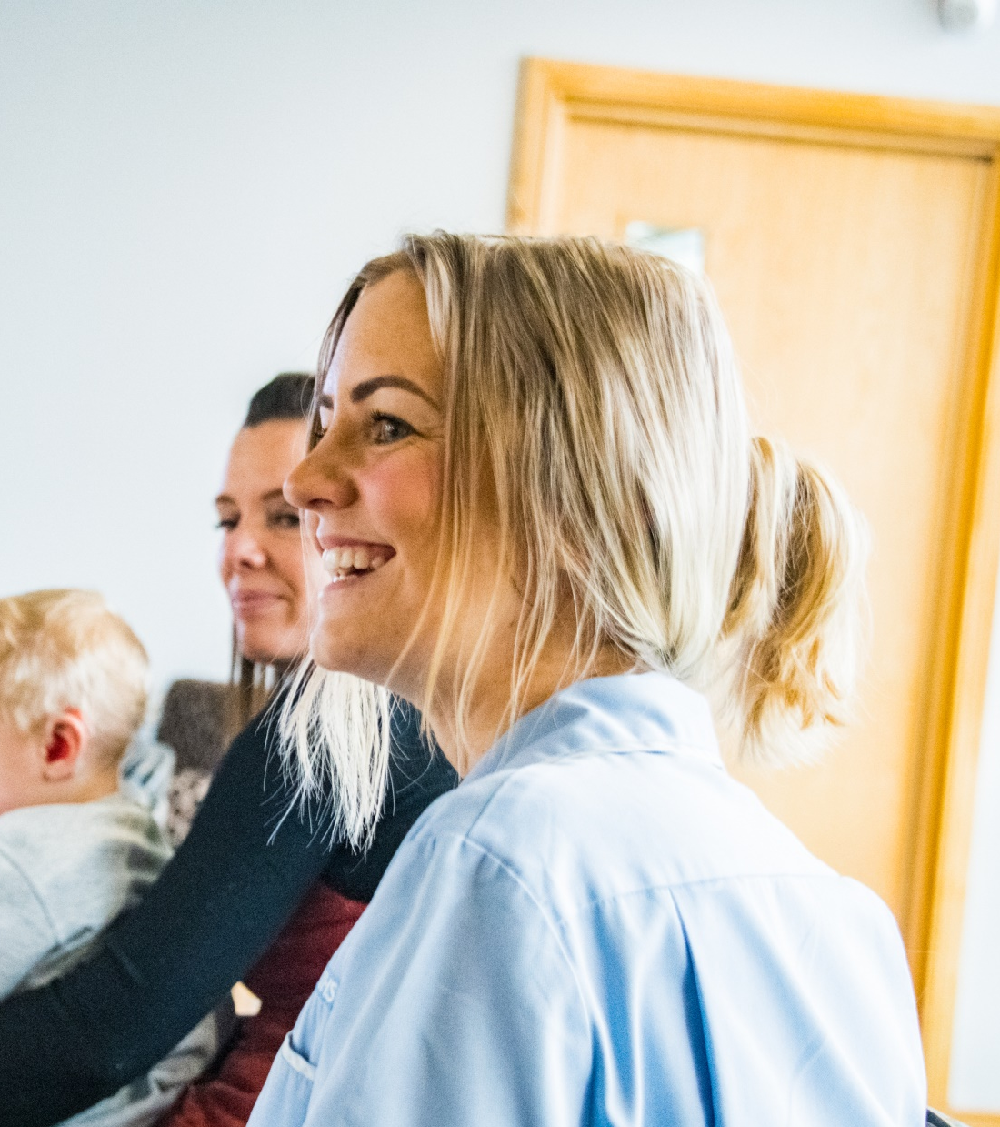


Vocal
Leads PPIE for the NIHR Manchester BRC and CRF.
We
Support staff and facilitate PPIE
Run research user groups and advisory groups
to support inclusive involvement in research
Develop large scale public engagement projects to inform and engage people with research
Provide learning and development for PPIE
One to one mentoring and support for PPIE
Notes:
https://www.manchesterbrc.nihr.ac.uk/wp-content/uploads/2018/03/BRC-and-CRF-PPIE-strategy-2018-2022-FINAL.pdf

Slide 5
What is
Public Involvement
and Engagement?

Slide 6
Public involvement and engagement
Involvement
People contributing their experiences to improve research
Engagement
Research shared with communities to stimulate interaction
Vocal approach
Bringing health research and people together for everyone’s benefit.
Notes:
Nothing about us without us.
Involvement- can include setting priorities, identifying research questions, developing funding applications, planning recruitment or study design
Engagement - Can include long term projects, one-off events, ongoing relationships, face to face and digital interaction
Point out that whilst involvement and engagement are traditionally seen distinct entities– our BRC/Vocal approach is to see an interactive cycle of engagement, involvement and research. We aim to build inclusive research community where researchers, patients, communities and partner organisations work together for the benefit of everyone.

Slide 7


Public Involvement
at the CRF
Governance and Decision Making
Members of the public and community leaders from Greater Manchester sit on a number of our boards at the Clinical Research Facility.
Patient Journey/ Patient Experience
Work carried out to improve the experiences of patients visiting our facilities.
Advisory Panels
Vocal runs a number of advisory panels that can be access by anyone who works at the CRF or BRC and would benefit from patient or public input for their research design or facility development.
Notes:
This can take many forms,
Traditionally involvement has taken place at the research design stage but we are working on ways we can ensur

Slide 8
Organisation of PPIE within MCRF
MCRF Governance Group
Neil Walbran – Healthwatch Manchester CEO
MCRF Executive Committee
Grace McCorkle - Public chair of Inclusive Research Group
MCRF Inclusive Research Group (under review)
Staff and public contributors
Outreach and engagement
Inclusive Research projects
Patient Experience projects
Notes:
Our Director Bella Starling also sits on the Executive Committee

Slide 9
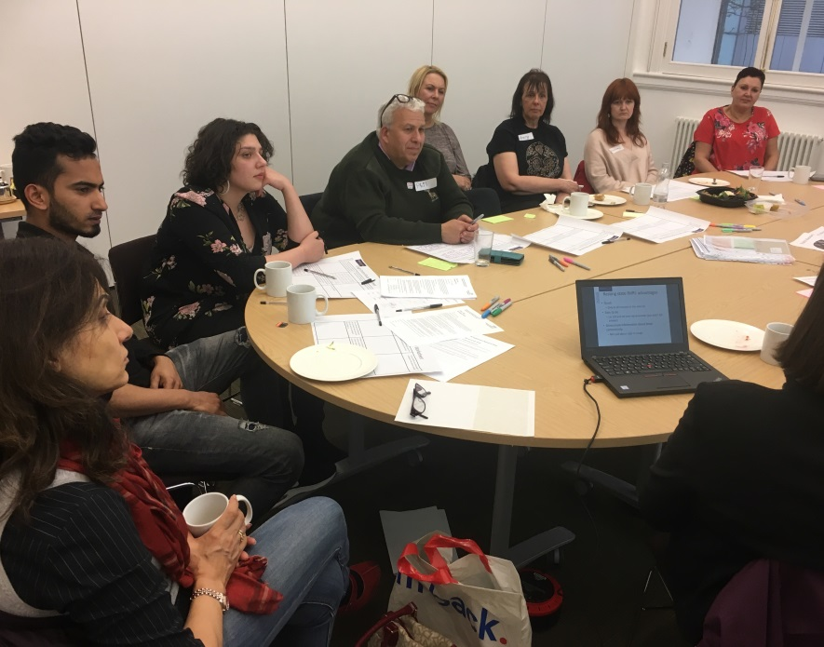
Research Advisory Groups
Inclusive Research Group
Previously the Involvement and Engagement Group
A group of staff, patients and members of the public
who support on patient experience and community
engagement work.
Voice Up
Young people in Greater Manchester who input into
CRF & BRC communications and research.
Black, Asian, Minority Ethnic Advisory Group (BRAG)
Ensures experiences and insights of BAMER
communities is embedded into the work of CRF & BRC
Deaf Experts by Experience (DEEG)
Notes:
Research advisory groups meet regularly to do things like, input into and shape research project, advise staff on patients journeys through facilities, patient proof information that is intended to go out to the public to make sure it’s easy to understand from a non-clinical perspective.
Being a member of a group of patients / members of the public who have an active interest in a health condition. Can include community leaders

Slide 10
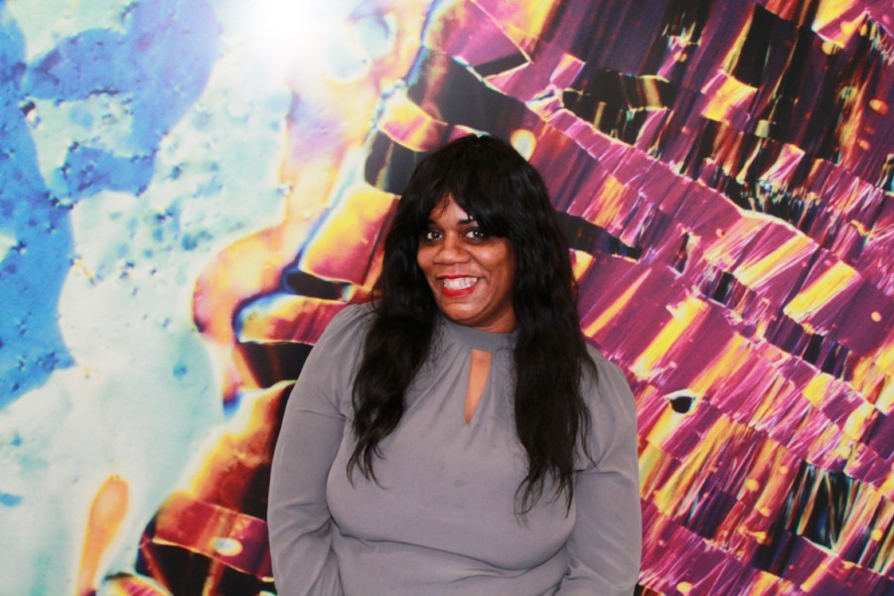
Health Inequality Steering Group
Aims
To collectively address health inequalities in the research that MBRC and MCRF designs, undertakes and disseminates
We will prioritise research that is:
most relevant to poor health outcomes and/or linked to GM priorities
examines barriers to participation and explore approaches to broaden access
develops more inclusive practices for both research participation and involvement.
Tracy Grey, Project Manager, Communities & inclusion. Background in Public Health, National lead for the North of England on health inequalities, NHS England
Notes:
https://www.manchesterbrc.nihr.ac.uk/how-we-do-it/addressing-health-inequalities/
Membership: Adaway Gareth; Arpana Verma; Kate Banks; Davine Forder (Public contributor); Ben Parker; Monika Cien; Gareth Price; Angela Kelsall; Lisa Miles; Alison Pierce; Helen Pidd; Bella Starling; Tracey Farragher; Tracy Grey
Background
The Health Inequalities Steering Group (HISG) was established to meet the aims articulated in the Manchester BRC and Manchester CRF applications and in response to the Manchester BRC Scientific Advisory Board recommendations and considerations arising from the Manchester CRF Governance relating to access to research.

Slide 11
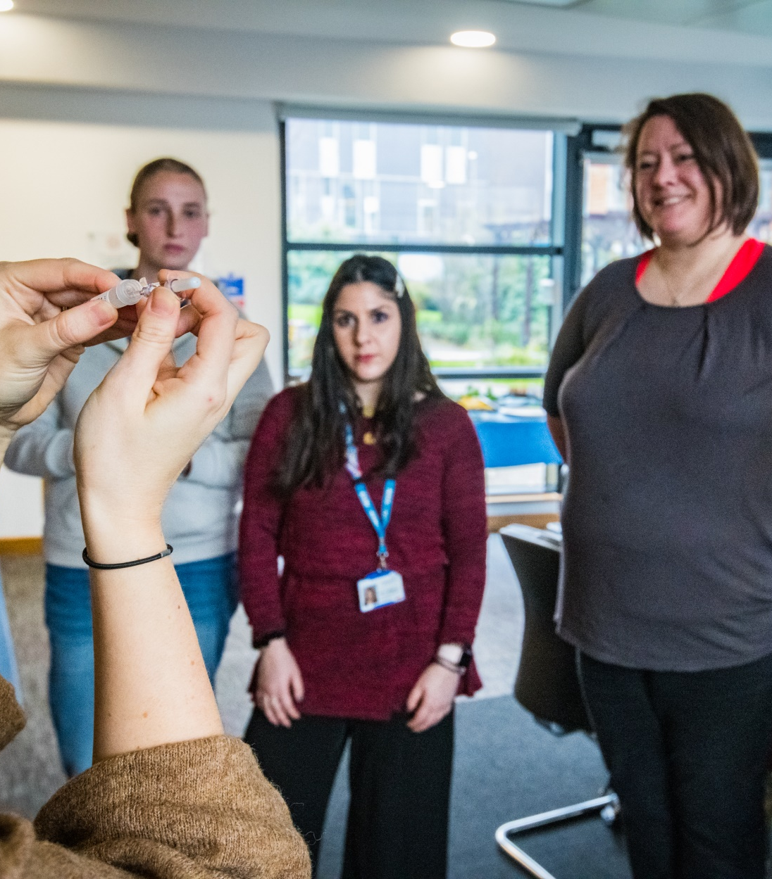
Public Engagement at
the CRF
Working with underserved communities
Using equalities data to target communities that we have not previously reached and understanding Greater Manchester's health prioritise
Raising Awareness of Health Research
Communicating the activities of the Manchester Clinical Research Facility and sharing opportunities to get involved.
Sharing research findings
Sharing research findings with targeted communities

Slide 12
Health Inequalities and Inclusive Research

Slide 13
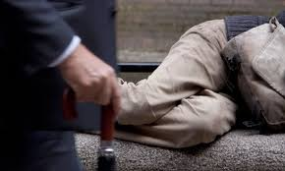
Health inequalities are the unjust and avoidable differences in people’s health across the population and between specific population groups.
Notes:
What are Health Inequalities? Public Health Scotland
This is Scotland focused but I think it’s the most useful page I’ve found so far. I’m hoping to produce a similar page for the briefing. We have similar disparities in life expectancy across Greater Manchester.
http://www.healthscotland.scot/health-inequalities/what-are-health-inequalities
Chapter 5: Inequalities in health, Health Profile for England: 2018
Health inequalities are avoidable and unfair differences in health status between groups of people or communities. In 2014 to 2016, the level of inequality, or gap, in life expectancy between the most and least deprived areas of England was 9.3 years for males and 7.3 years for females.
https://www.gov.uk/government/publications/health-profile-for-england-2018/chapter-5-inequalities-in-health#:~:text=1.-,Main%20messages,and%207.3%20years%20for%20females.

Slide 14
Health inequalities are:
1. Avoidable
2. Socially determined
3. Often beyond an individuals control
Notes:
Health inequalities go against the principles of social justice because they are avoidable. They do not occur randomly or by chance. They are socially determined by circumstances largely beyond an individual’s control. These circumstances disadvantage people and limit their chance to live longer, healthier lives.

Slide 15
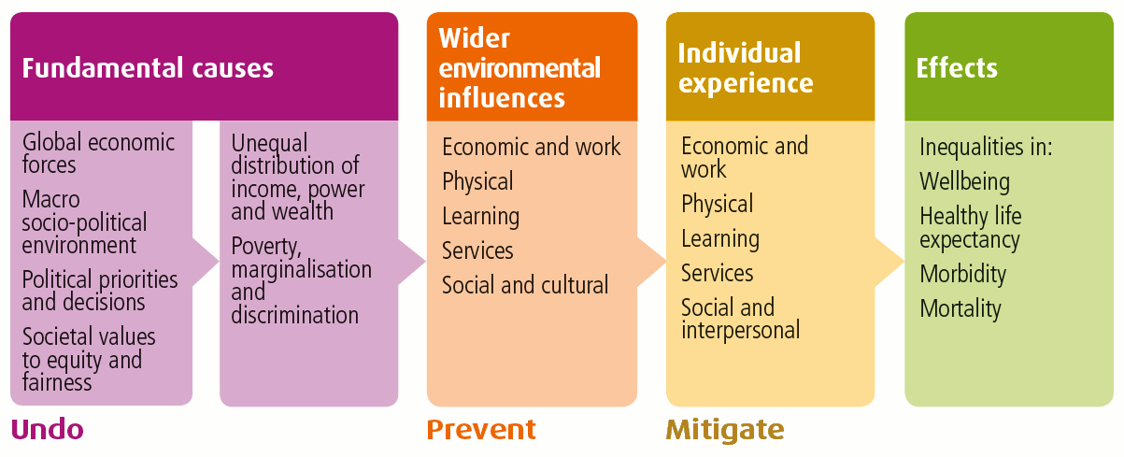
Notes:
The diagram here shows the causes, influences and experiences that effect healthy life expectancy.

Slide 16
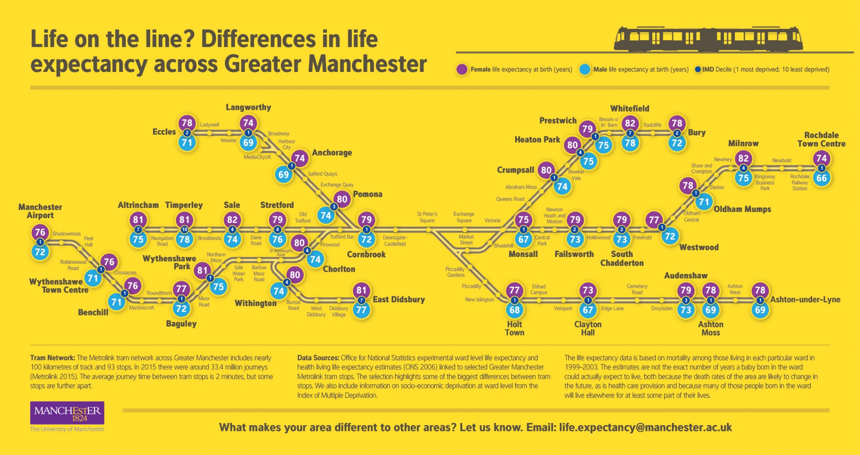
Notes:
Note that the life expectancy differs by 12 years between Rochdale and Timperley. A journey of just 75 minutes.

Slide 17
What is health equity?

Slide 18
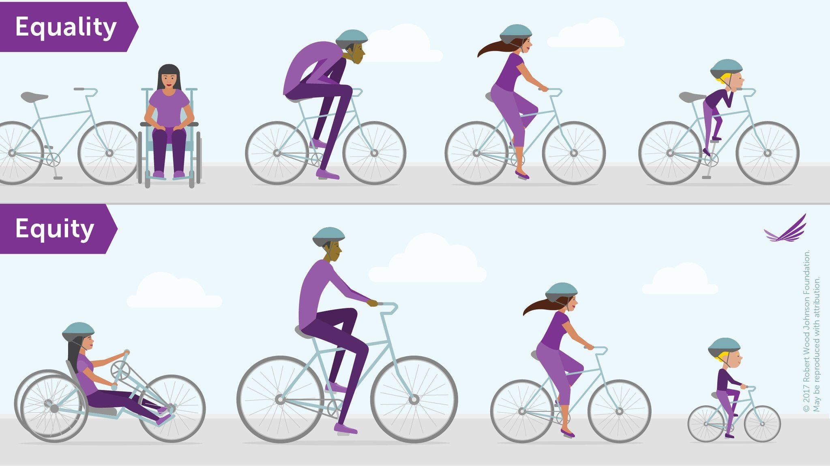
Notes:
Health equity means that everyone has a fair opportunity to be healthy. The work involves removing barriers to health such as location, wealth, discrimination and their consequences, including powerlessness, entitlement and lack of access to health care, health research, good jobs with fair pay, quality education and housing, and safe environments.
Robert Wood Foundation

Slide 19
Cancer

Slide 20
People in the most socio-economically
deprived areas in England are 20% more likely to have their cancer diagnosed at a late stage than people in the least deprived areas
Notes:
https://www.macmillan.org.uk/assets/health-inequalities-paper-april-2019.pdf

Slide 21
People in the most socio-economically
deprived areas receive only half the number of referrals to early stage clinical trials.
Notes:
https://www.macmillan.org.uk/assets/health-inequalities-paper-april-2019.pdf

Slide 22
Age standardised cancer mortality in the most deprived populations is 50% higher than in the least deprived.
Notes:
https://www.macmillan.org.uk/assets/health-inequalities-paper-april-2019.pdf

Slide 23
One of the greatest barriers to acquiring knowledge related to black and minority ethnic health is the accurate collection and recording of ethnic monitoring data.
Better Health, Race Equality Foundation
Notes:
http://raceequalityfoundation.org.uk/wp-content/uploads/2018/07/REF-Better-Health-471-1.pdf
With regards to breast cancer, Black women were more likely to be diagnosed at late stage compared with White women.
Those in the Black ethnic group were also more likely to be diagnosed with colorectal and lung cancer at late stage compared with other ethnic groups
For prostate cancer the pattern was different, with those identifying with White, Asian or Chinese ethnic group having the highest proportions of late stage diagnosis.

Slide 24
Respiratory

Slide 25
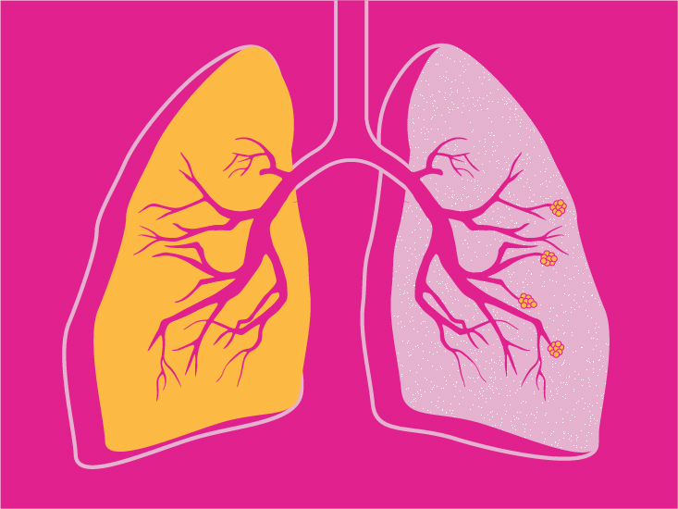
People from the most deprived section of society are two-and-a-half times more likely to have chronic obstructive pulmonary disease (COPD).
NHS England

Slide 26
COVID & health inequalities
Greater COVID burden with: older age, male sex, obesity, comorbidities (underlying health conditions) and poverty (Treweek et al, Lancet 2020)
Black, Asian & minority ethnic (BAME) communities are at increased risk of infection from COVID (Pan et al, EClinicalMedicine 2020)
Bangladeshi, Pakistani, Chinese, Indian & Black Caribbean ethnic groups have worse outcomes than White British (PHE, June 2020)
Jewish and Muslim people at particularly high risk (Nazroo et al, 2020)
High economic, social & psychological impacts on women (Nazroo et al, 2020)
Increased mortality risk for disabled people (Nazroo et al, 2020)
Notes:
33% of patients critically ill with confirmed COVID-19 in intensive care in the UK were from BAME groups, despite them comprising about 13% of the UK population.
And this is being played out in communities across Manchester and beyond

Slide 27
COVID: clinical research response & equity
Those who stand to benefit the most from clinical research, must be included in research, but:
Fewer BAME people take part in clinical research (Equality & Diversity in Science, 2019)
People from ethnic and lower socioeconomic groups feel much less confident of being treated with dignity and respect in research (Hunn, Health Research Authority, 2018)
Imbalanced power relationships between people, researchers and institutions (NIHR INVOLVE, Being Inclusive guidance, 2018)
No obligation to collect ethnicity information in clinical trials in the UK
Notes:
eg. In clinical trials for 24 of the 31 cancer drugs approved in the US since 2015, fewer than 5% of the patients were Black or African American
Why BAME people don’t take part in research is down to numerous reasons, including hesitancy on the part of participants, lack of inclusion by health-care staff or researchers, and other socioeconomic factors and entrenched structural
inequalities. These separately and collectively result in a range of outcomes from non-participation to exclusion, mostly inadvertent but sometimes by design (eg. inclusion and exclusion criteria in clinical trials). Barriers to participation in research include language challenges, low research awareness or mistrust of research, stigma, cultural values and beliefs about research, poor engagement from researchers, and general inaccessibility to research in deprived areas, including concerns of costs
of time and money. Recruitment strategies and information provision approaches that work for the majority
population may be ineffective for other parts of the population; there is little tailoring

Slide 28

Of 1,518 COVID-19 studies, only six studies were collecting data on ethnicity
Notes:
A recent study found that of 1,518 COVID-19 studies registered on ClinicalTrials.gov, only six studies were collecting data on ethnicity
One of the greatest barriers to acquiring knowledge related to black and minority ethnic health is the accurate collection and recording of ethnic monitoring data.

Slide 29
Current Work
Notes:
So this sounds enourmous! But it’s important to understand that we can all play a part. Improving access to health research, and developing research that is relevant to those who might stand to benefit from it the most, is an important part of health equity.

Slide 30
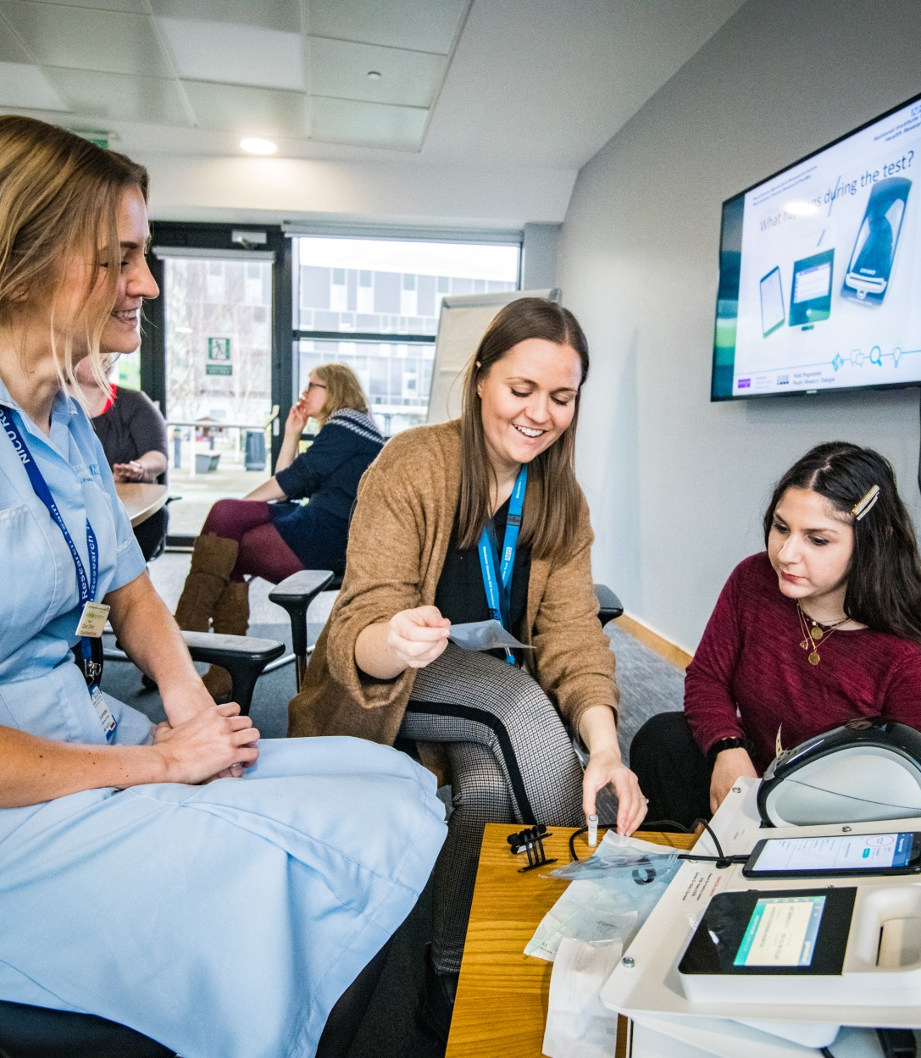

Equalities Data: Pilot Findings
To explore the feasibility of collecting demographic data from CRF research participants
To describe the demographic characteristics of research participants at Manchester CRF who took part in the pilot.
Notes:
The form asks a number of questions about a persons background . These include questions about ethnicity, geographic location, gender, sexual orientation

Slide 31
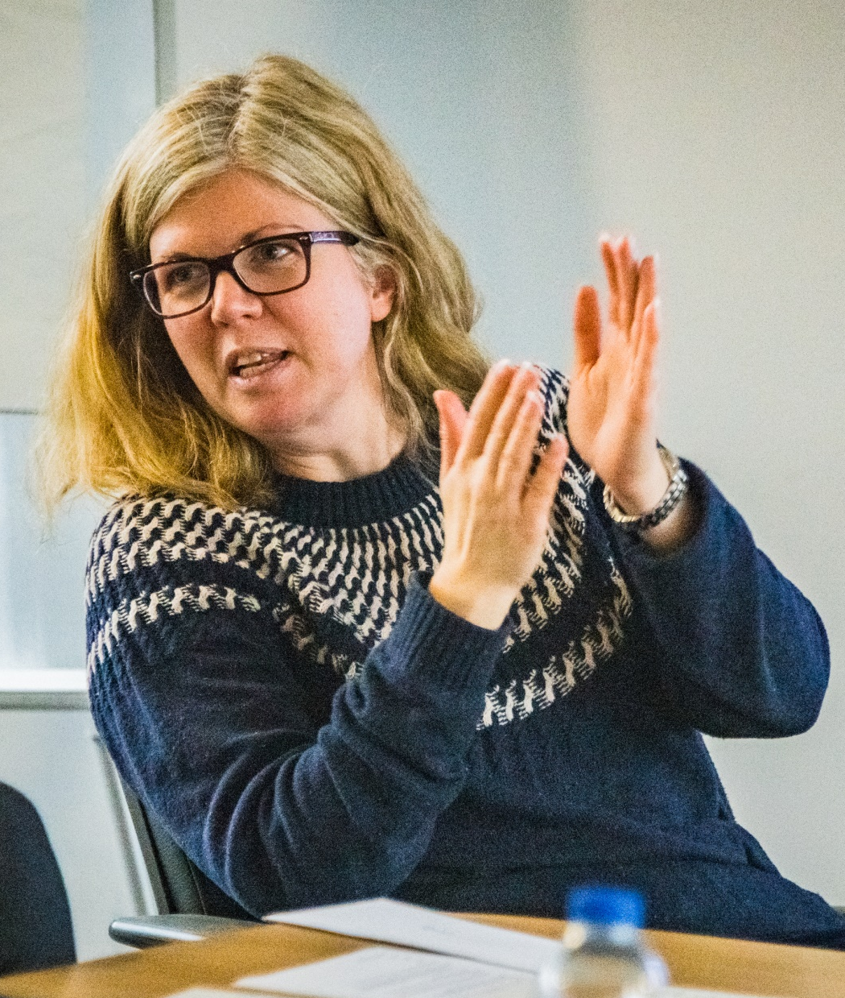



Method
A demographic questionnaire was developed and given to CRF research participants between January and March 2020 by CRF research nurses.
Data collected from all CRF sites
Insights on the feasibility of collecting the data were also collected

Slide 33
128 questionnaires were returned (return rate across CRF sites (9% - 34%).
Questionnaire fields were well completed apart from education level (21%) and postcode (28%).
It was challenging to implement the form for studies where patients did not attend the CRF eg. sample based studies

Slide 34

ESR versus GM data
 | ESR N=128 | GM data
Ethnicity %White British | 84% | 83.8%
Age % 60 and over % 30 and under | 57% 20% | 22% 40%
Gender %Male %Female | 51% 49% | 50.3% 49.7%
Sexual orientation % Heterosexual | 95% | 93%
Religion % Christianity % Atheism % Islam | 65% 22% 3% | 65.8% 22.1% 9.2%

Slide 35
ESR versus GM data II
 | ESR N=128 | GM data
Disability % Reporting that they have a disability | 27% | 17.6% (just Manchester figure)
Working status %Working | 33% | 72.7%
Education status % University education | 35% | 32%

Slide 36
What’s next?

Slide 37
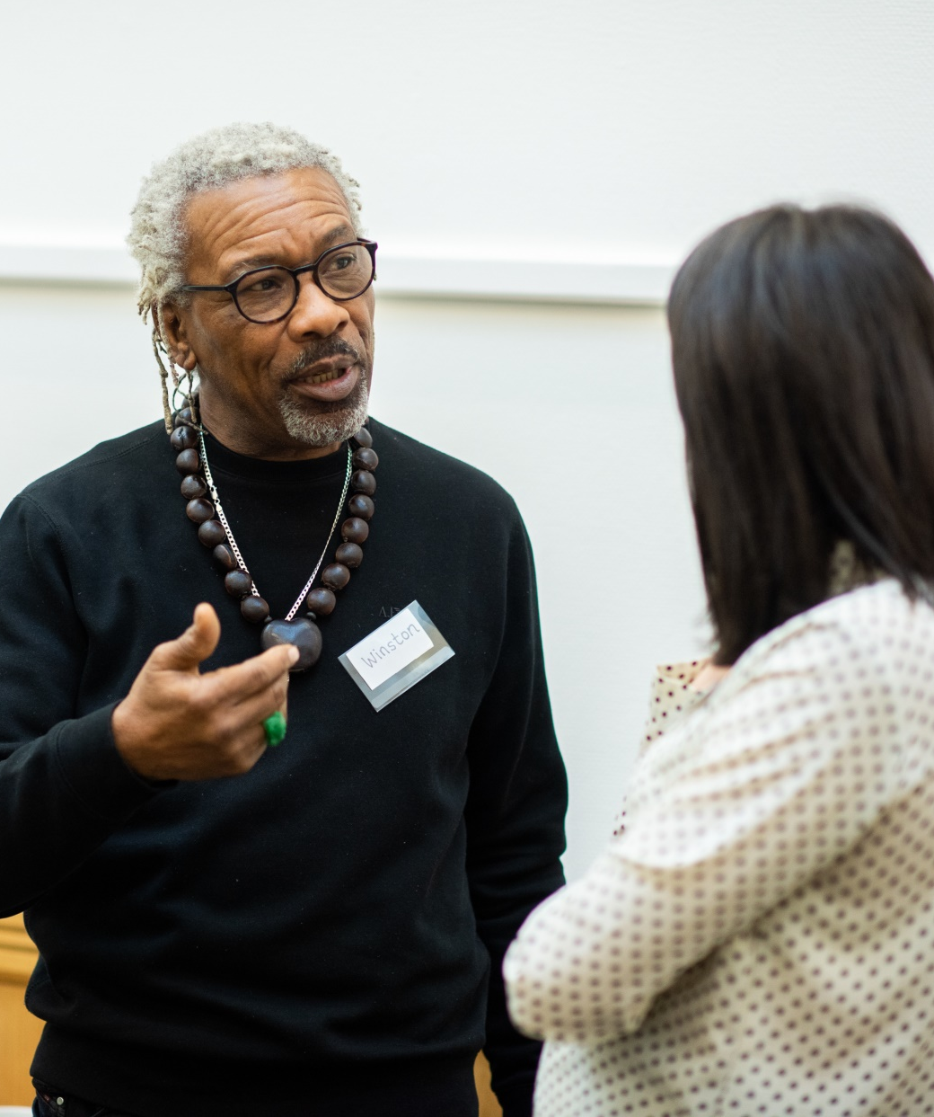
Equalities Data: Next Steps
From 1 December 2020 all patients will be asked to fill out an equalities monitoring form the first time they visit Manchester Clinical Research facility
Who will this affect?
If you’re a ward clerk, research nurse or health care assistant then this may affect you.
How will it work?
The process will differ at each site. Speak to your line manager for more information.
What will happen with the data?
We use the anonymous data to target future engagement projects and identify communities that we don’t yet reach.

Slide 38
Data Collection
Staff at CRF sites collection anonymous equalities data from patients
Data Process
Data will be processed by the CRF data team and analysed by Vocal
Outreach and Engagement Activity
Vocal Team work with the identified underserved communities

Slide 39
Talking to patients about the form
The form is optional. Patients do not have to fill it out.
It may help to reassure them that it is anonymous
Translations are available for those that might need one.
It’s ok to offer help someone fill out the form but the need to answer the questions themselves.
Notes:
Urdu, Arabic, Chinese, Bengali, Polish, Panjabi, Somali

Slide 40

Running pilot to ensure processes are sound.
Identifying underserved areas and working to raise awareness of health research and the CRF
Recruiting existing patients and community public contributors to the Inclusive Research Group

Slide 41


Thank you
Hannah Turner-Uaandja, Project Manager
Hannah.Turner-Uaandja@mft.nhs.uk

Slide 42
NIHR Public Involvement Standards at the CRF
Inclusive Opportunities
We are working with staff to ensure our public involvement work targets underserved communities
Support & Learning
We use plain language for two way, targeted communications and intend to review patient information developed through the CRF.
Working Together
Staff and patients work together on PPIE projects at the CRF and through
Impact
We record the work we deliver and the impact it has on research. We use this information to build best practice.
Governance
A member of the public sits on our governance and leadership board so that our decisions promote and protect the public interest.
Support & Learning
We offer and promote learning that builds confidence and skills for public involvement.
Notes:
We work the NIHR Public Involvement Standards. The standards are a framework that allow organizations like the CRF to understand what good public involvement in research looks like and how we can work to support studies to deliver that.
So what does public involvement look like at our sites?

Slide 43
Further Reading
What are Health Inequalities? Public Health Scotland
This is Scotland focused but I think it’s the most useful page I’ve found so far. I’m hoping to produce a similar page for the briefing. We have similar disparities in life expectancy across Greater Manchester.
http://www.healthscotland.scot/health-inequalities/what-are-health-inequalities
Chapter 5: Inequalities in health, Health Profile for England: 2018
Health inequalities are avoidable and unfair differences in health status between groups of people or communities. In 2014 to 2016, the level of inequality, or gap, in life expectancy between the most and least deprived areas of England was 9.3 years for males and 7.3 years for females.
Public Health: Inequalities in Health link (can also be found in notes)
The forgotten, the ignored and the under-served – trials cannot continue to fail large parts of society
Prof Shaun Treweek et al. blog provides a great overview with some really good links should you want to explore a bit. Blog link (can also be found in notes)
Notes:
Chapter 5: Inequalities in health, Health Profile for England: 2018
Health inequalities are avoidable and unfair differences in health status between groups of people or communities. In 2014 to 2016, the level of inequality, or gap, in life expectancy between the most and least deprived areas of England was 9.3 years for males and 7.3 years for females.
https://www.gov.uk/government/publications/health-profile-for-england-2018/chapter-5-inequalities-in-health#:~:text=1.-,Main%20messages,and%207.3%20years%20for%20females.
The forgotten, the ignored and the under-served – trials cannot continue to fail large parts of society
Prof Shaun Treweek et al. blog provides a great overview with some really good links should you want to explore a bit.
http://blogs.biomedcentral.com/on-medicine/2020/10/01/the-forgotten-the-ignored-and-the-under-served-trials-cannot-continue-to-fail-large-parts-of-society/
NIHR INCLUDE ETHNICITY FRAMEWORK
This is a branch of the project that focuses on BAME representation. I personally love this page because it has a fab video full of patient perspectives.
http://blogs.biomedcentral.com/on-medicine/2020/10/01/the-forgotten-the-ignored-and-the-under-served-trials-cannot-continue-to-fail-large-parts-of-society/

Slide 44
Returns by site
 | N=128
Returns by site MRI Wythenshawe The Christie RMCH | 23% 48% 19.5% 9%

Slide 45
ESR Demographic data 1
 | N=128 | Missing data
Ethnicity %White British | 84% | 0
Age % 60 and over % 30 and under | 57% 20% | 14
Gender %Male %Female | 51% 49% | 0
Sexual orientation % Heterosexual | 95% | 7
Religion % Christianity % Atheism % Islam | 65% 22% 3% | 15

Slide 46
ESR Demographic data II
 | N=128 | Missing data
Disability % Reporting that they have a disability | 27% | 5
Working status %Working % Unable to work % Retired | 33% 9% 41% | 11
Education status % University education % Higher education % Secondary education | 35% 30% 33% | 27

Slide 47
ESR versus GM data
 | ESR N=128 | GM data
Ethnicity %White British | 84% | 83.8%
Age % 60 and over % 30 and under | 57% 20% | 22% 40%
Gender %Male %Female | 51% 49% | 50.3% 49.7%
Sexual orientation % Heterosexual | 95% | 93%
Religion % Christianity % Atheism % Islam | 65% 22% 3% | 65.8% 22.1% 9.2%

Slide 48
ESR versus GM data II
 | ESR N=128 | GM data
Disability % Reporting that they have a disability | 27% | 17.6% (just Manchester figure)
Working status %Working | 33% | 72.7%
Education status % University education | 35% | 32%

Slide 49
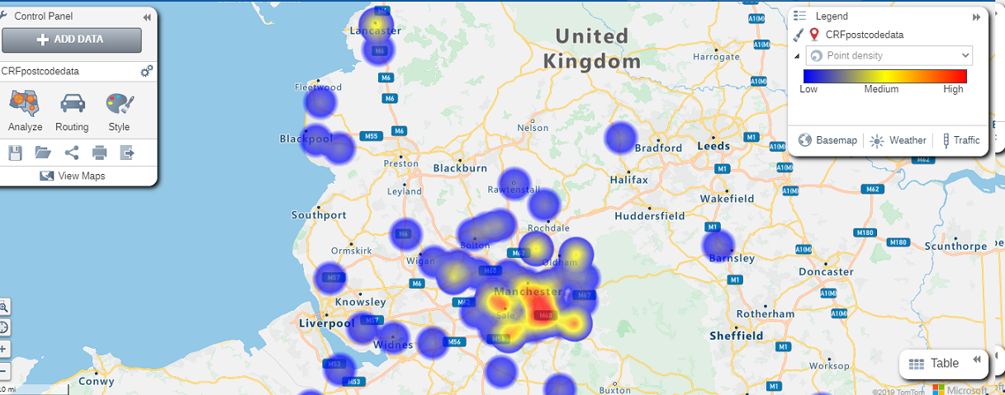
Postcode mapping

